Slide 1
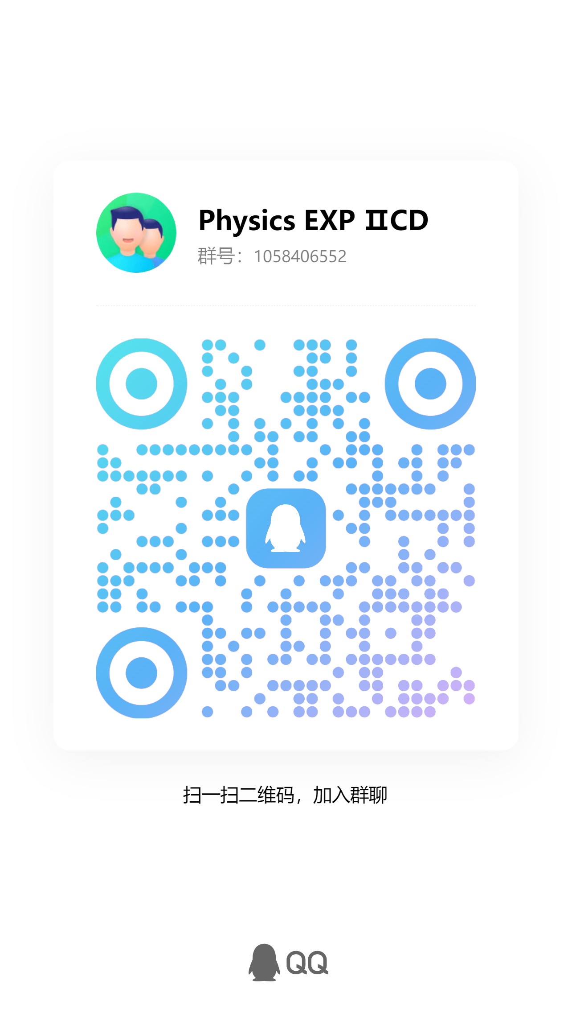

Slide 2
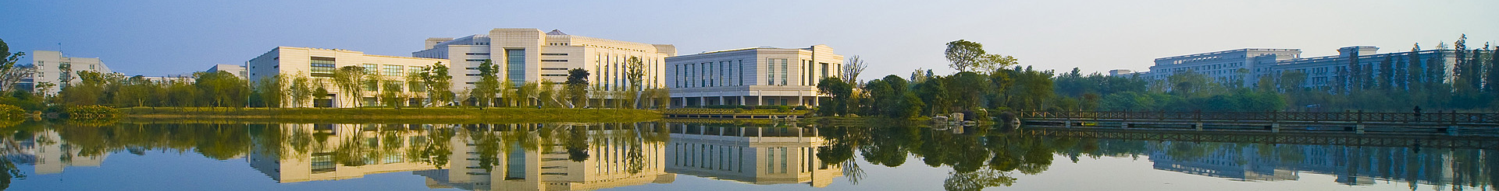
Measuring Laser wavelength and Index of Refraction of Air by Michelson Interferometer
University Physics Experiment Center

Slide 3
outline
Content
1 Background
2 Aim
3 Principle
4 Equipment
5 Procedure
6 Questions
7 Expand training
8 Experimental data recording and processing

Slide 4
1. background
Significance
Invariance of the speed of light ，promote the development of special relativity
Michelson's important contribution
Determination of the speed of light
1924～1926Southern California mountains 22 miles long optical path ，299796±4 km/s
Determination of the reference length
1893， Determination of the wavelength of the red cadmium line 643.84696 nm，for the standard length， recognized by the world ，until 1960。
Michelson interferometer
for： Michelson - Morley experiment 、 LIGO (LIGO) measuring gravitational 、 Detecting extrasolar planets
Echelle
Especially for Broad-band, high dispersion, high resolution。

Slide 5
2. aim
2. aim
Familiar Michelson interferometer configuration, grasp the adjustment methods and techniques.
Understanding and equal inclination interference conditions and equal thickness interference fringes changes of formation.
measuring the wavelength of the light source and measuring the refractive index of air.
Enhance the fringe visibility and awareness of temporal coherence.

Slide 6
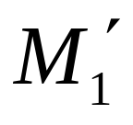
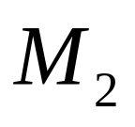
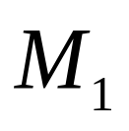

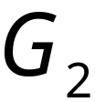
3. 实验原理
3. principle
3.1 Michelson interferometer
d
2
Laser
1
Half-
membrane
1’
2’
Compensation
Board
The same： M1, M2 air film between the interference generated。

Slide 7
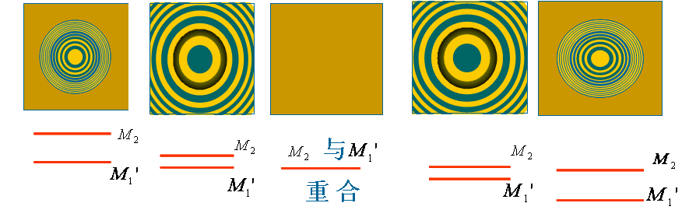
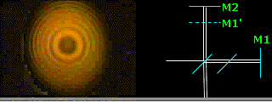
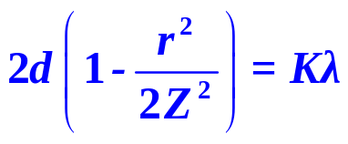
3. principle
3.2 Equal thickness interference and equal inclination interference
S₂
M1 ⊥ M2 perpendicular ➔Equal inclination interference
2d
S₁
d
S
P
Bright fringes conditions ：

Slide 8
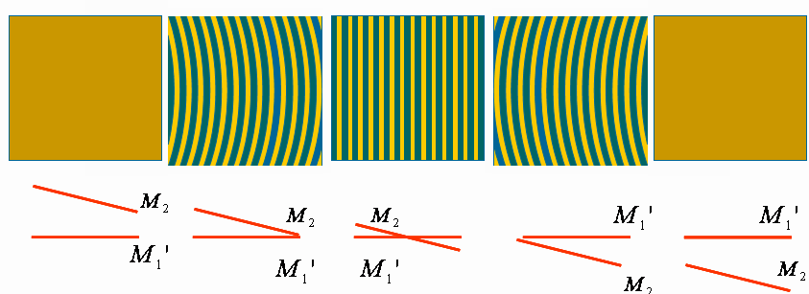
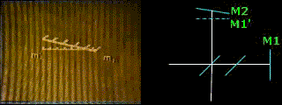
3. 实验原理
3.2 Equal thickness interference and equal inclination interference
S₂
M₁ no ⊥ M₂➔Equal thickness interference
S₁
d
S
P

Slide 9


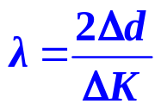
3. principle
3.3 application
S₂
（1）for the wavelength of light
2d
S₁
Bright fringe：
center：
d
as：
In advance：
S
In this experiment：
Count for 50 bright fringes，and record the length of lens moving
P

Slide 10

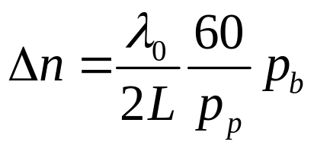

3. 实验原理
3.3 application
S₂
（2）measurement air Index of refraction
2(d+ΔnL)
S₁
Bright fringe center：
air
Refraction concerned with air pressure、：
d
pressure：
S
In this experiment：
Count for 60 bright fringes, and record the pressure before and after.
P

Slide 11
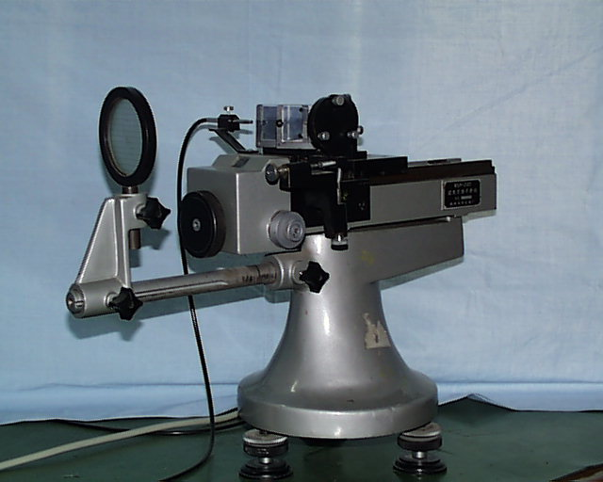
4. 实验器材
4. Equipment
Splitter plate
Compensation
screen
mirror
Coarse-adjust
Adjust mirror angle
Micro-adjust
Adjust mirror angle

Slide 12
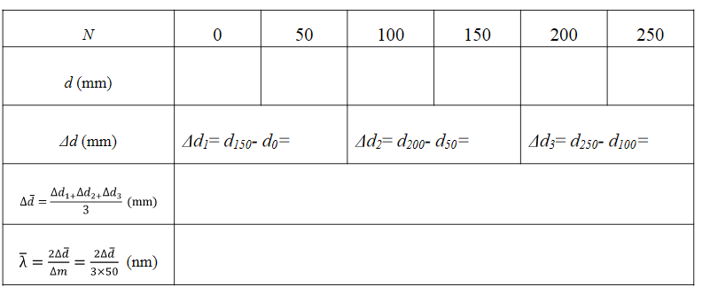
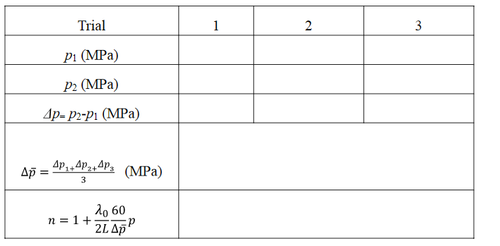
8. 实验数据记录及处理
8. data
8.1 measurement He-Ne laser wavelength
table1 measurement He-Ne laser wavelength
8.2 measurement air index of refraction
Table 2 measure of air index of refraction

